Slide 1
Unit 2, Wk 5
Vocabulary and Definitions

Slide 2
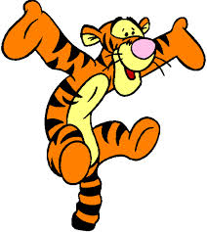
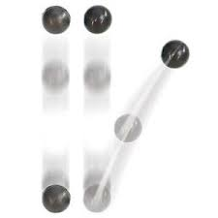
Bounce
Define: to spring back up after hitting something.
Example: Keith likes to bounce a soccer ball off his head.
Ask: How many times can you bounce a ball without stopping?

Slide 3
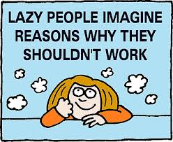
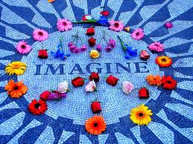
Imagine
Define: dream
Example: Mandy likes to imagine what her dream house might look like.
Ask: What do you imagine when you daydream?

Slide 4
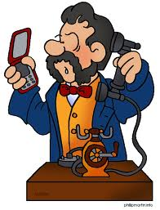
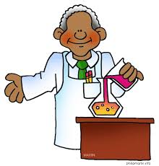
Inventor
Define: someone who creates something new.
Example: Thomas Edison was the inventor of the first light bulb.
Ask: What does an inventor do?

Slide 5
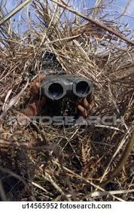
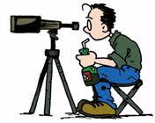
Observer
Define: watches or notices something.
Example: Jason is a good observer and enjoy watching birds.
Ask: Can you tell about a time when you were an observer at an event.

Slide 6
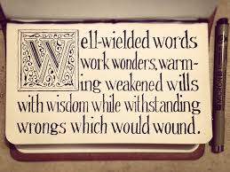
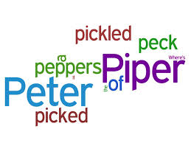
Alliteration
Define: the commencement of two or more words of a word group with the same letter, as in the pink pot popped.
Example: “Poets paint precise pictures” is an example of alliteration.
Ask: Can you give another example of alliteration?

Slide 7
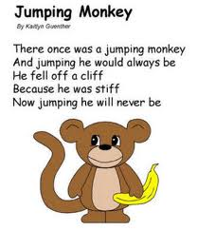
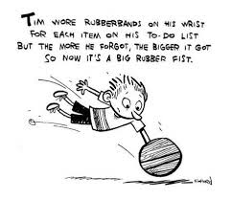
Limerick
Define: a funny poem with only five lines.
Example: Dan’s limerick had five lines and made the class laugh.
Ask: How is a limerick different from other places?

Slide 8
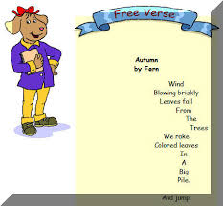
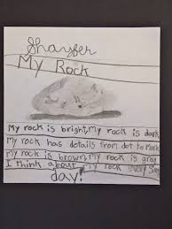
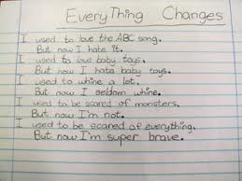
Free Verse
Define: unrhymed verse without a pattern.
Example: Jeremy likes to write free verse poems because they don’t need to rhyme.
Ask: What would you write a free verse poem about?

Slide 9
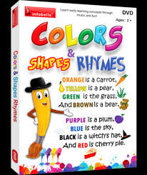
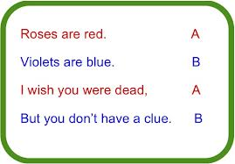
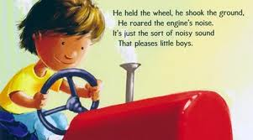
Rhyme
Define: words that sound alike at the ending sound such as cat and hat.
Example: The words cat and bat rhyme because they end in the same sound.
Ask: Can you name two other words that rhyme?

